Slide 1
Audience Analysis

Slide 2
Goals of the Lesson
Understand
Understand the overlap between writing and public speaking
Identify
Identify techniques for analyzing a target audience
Understand
Understand the three methods of audience analysis
Distinguish
Distinguish between the five categories of audience analysis
Recognize
Recognize the difference between beliefs, attitudes, and values
Apply
Apply the rhetorical devices to appeal to a target audience

Slide 3
Lesson Overview
Approaches to Audience Analysis
Direct Observation
Inference
Categories of Audience Analysis
Situational
Demographic
Data sampling
Psychological
Multicultural
Interest and Knowledge
What is Audience Analysis
Target Audiences
Benefits of Analysis
This Photo is licensed under CC BY-SA-NC

Slide 4
What is Audience Analysis?
Analyzing all pertinent elements that define and characterize your audience
Finding common ground
Transactional Process (2-way)
Notes:
“When you ask an audience to listen to your ideas, you are inviting them to come partway into your personal and professional experience as an expert speaker. And, in return, it is your responsibility and obligation to go partway into their experience as an Audience.”

Slide 5
How do I perform an analysis of my audience?
Methods of Audience Analysis
Direct Observation
Inference
Data Collection
Categories of Audience Analysis
Situational
Demographics
Psychological
Multicultural
Interest and Prior Knowledge

Slide 6
Methods of Analysis

Slide 7
Analysis by Direct Observation
Identifying information about the audience gathered through the use of the natural senses and direct experience.
Knowledge we collect…
has more impact than what we learn indirectly
is retained for longer periods of time
is knowledge we’re more likely to trust
Think of your audience as unique and individual people
Unacquainted Audience Presentation
The Essay
This Photo by Unknown Author is licensed under CC BY-SA
Notes:
“Not understanding the basic demographic characteristics of an audience, or further, that audience’s beliefs, values, or attitudes about a given topic makes your presentation goals haphazard, at best”

Slide 8
Analysis by Inference
INFERENCE: a reasoned tentative conclusion or logical judgement on the basis of available evidence and patterns within it
Observation
Patterns
Analysis
Theory
A form of critical thinking that creates a logical extension of your observations
Involves identifying connections, distinctions, and predictions
Can, of course, be wrong

Slide 9
Performing the Analysis

Slide 10
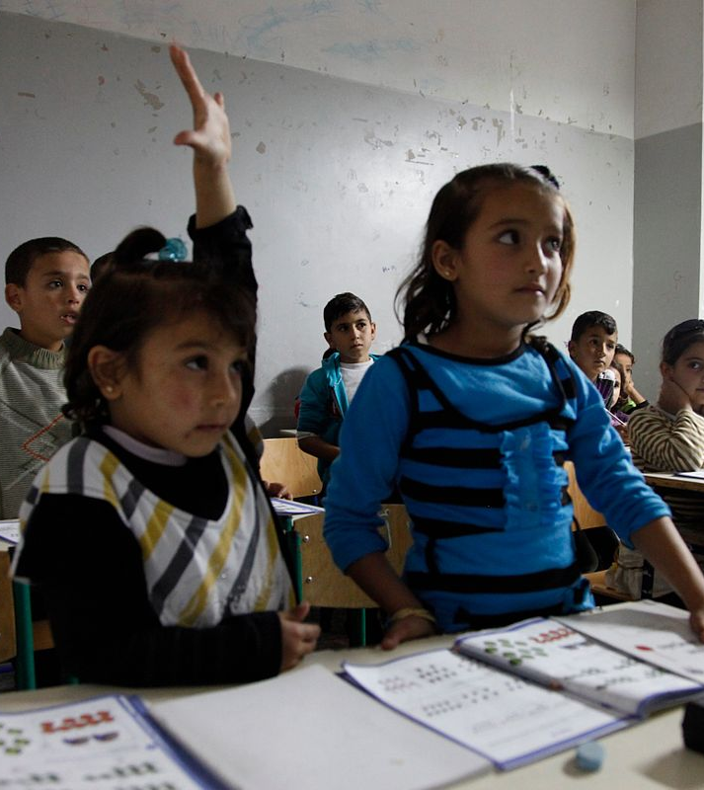
Situational Analysis
Why is your audience assembled?
Voluntary
Paid
Captive
Mixed Hybrid-Captive
Affects the speaker’s tone and agenda
This Photo by Unknown Author is licensed under CC BY-SA

Slide 11
Demographic Analysis
A classification of characteristics of people
A process of (1)gathering and (2)interpreting data
Regardless of demographics, speakers are ethically bound to their motives and the truth
This Photo by Unknown Author is licensed under CC BY-NC-ND

Slide 12
Psychological Analysis
Audiences always have attitudes, beliefs, and values towards your ideas
ATTITUDES:
a learned disposition to respond in a consistently favorable or unfavorable manner with respect to a person/object/event/idea
BELIEFS:
Principles or assumptions about the universe, tied to ideas and not issues. Generally more durable than attitudes, but still malleable.
VALUES:
A core underlying principle that regulates our beliefs and guides our attitudes.

Slide 13
“How To Disagree Better” by Natasha Crain
Attitudes
Beliefs
Values

Slide 14
Multicultural Analysis
language
cognition
education
social values
communication
Demography is basic and statistical
Multicultural analysis develops the capacity to appreciate other cultures and perspectives and use rhetorical skills necessary to affectively address diverse groups.

Slide 15
Interest & Knowledge Analysis
Topic Interest is often related to the uniqueness of the speaker’s topic
Topic Knowledge is the average amount of information a given audience knows about the presented topic
Faking knowledge can result in a loss of credibility

Slide 16
Combining the Categories of Audience Analysis

Slide 17
Goals of the Lesson
Understand
Understand the overlap between writing and public speaking
Know
Know the three methods of audience analysis
Distinguish
Distinguish between the five categories of audience analysis
Recognize
Recognize the difference between beliefs, attitudes, and values
Apply
Apply the rhetorical devices to appeal to a target audience
Identify
Identify techniques for analyzing a target audience

